Slide 1
Portable Extenstible Toolkit for Scientific Computations (PETSc)
A complete scalable ODE solver library that solves nonlinear time-dependent partial differential equations (minus the discretization).
PETSc presently has an enormous variety of linear solvers and preconditioners suitable for a variety of application areas such as electromagnetics, climate modeling, image processing, etc
Additionally, there are nonlinear solvers available in PETSc that can make use of the linear solvers and preconditioners.
Can be used with libmesh (which provides meshes and discretizations) for a complete scalable PDE solving environment.

Slide 2
Single-Click Installers for PETSc
and eventually other SciDAC FASTMath Software
Installing open source scientific software toolkits like PETSc on Microsoft Windows is often a difficult process for industrial firms.
Tech-X is providing single-click installers for fast and easy installation of PETSc on Microsoft Windows, Linux, and Mac OS X.
The single-click installers will install the necessary libraries and provide examples available through Integrated Development Environments, i.e. Windows Visual Studio.
Free test versions of these libraries will be made available to customers that only run on a single processor and in debugging mode while pay versions will be available that make use of multiple processors and/or GPUs.

Slide 3
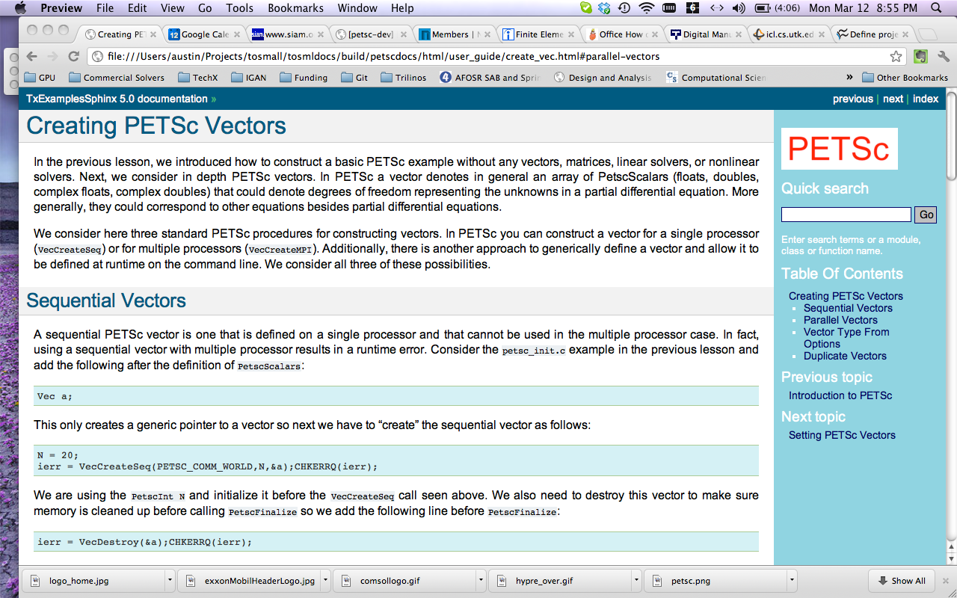
PETSc Documentation for Industry
A beginner’s guide

Slide 4
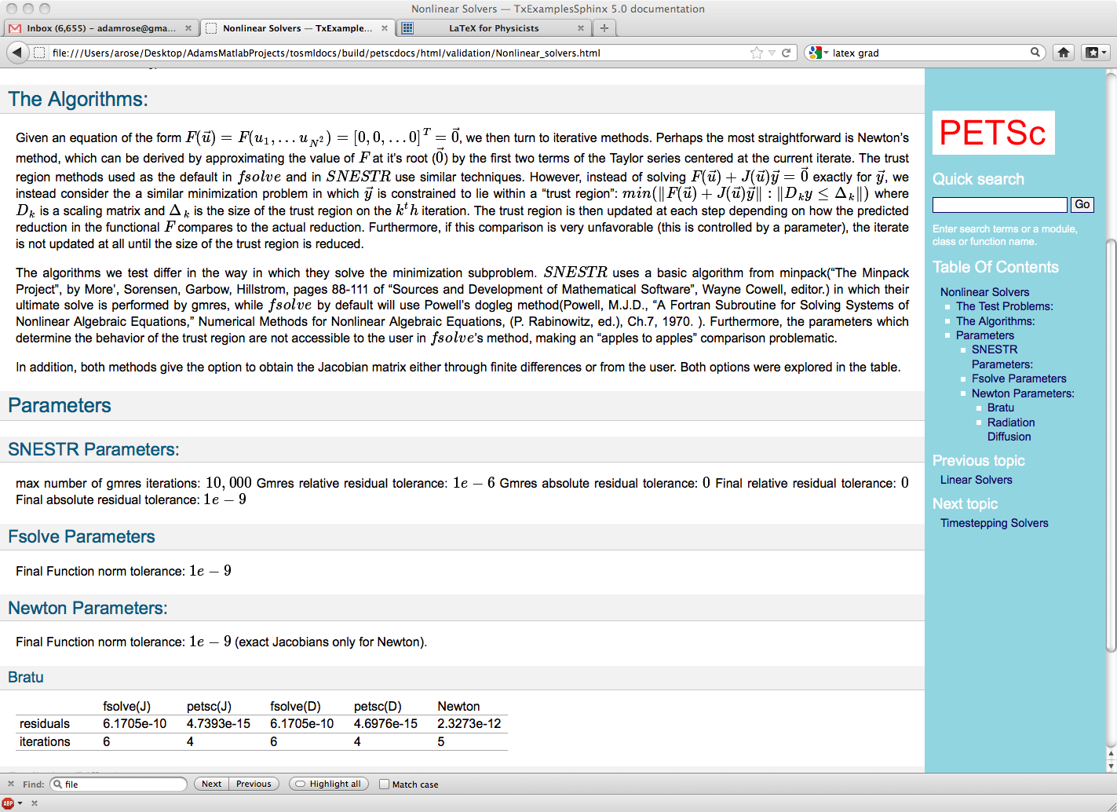
PETSc Verification for Industry
A comparison to Matlab’s fsolve

Slide 5
Custom Builds with
Consulting for Industry
Tech-X will also work with customers that have specific demands and provide custom solutions.
PETSc developers can also be brought in for consultation on development issues.
Tech-X previously built a custom build of PETSc for Henry Freund of SAIC (currently Los Alamos National Laboratory) that enabled a Poisson solver on a cylindrical mesh for Naval Free Electron Laser applications.
Tech-X has also had numerous discussions with companies who have an interest in accelerating their software with GPUs via algorithms made available through PETSc.

